Slide 2
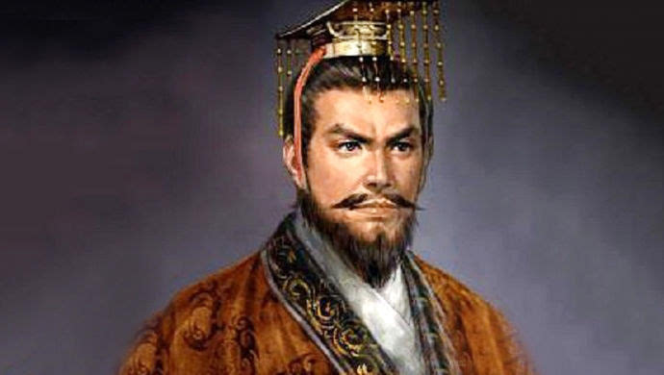
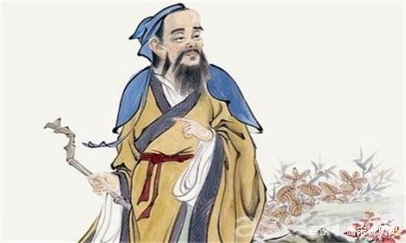
“You and your two brothers are all skilled in medicine, which of you is the best?
Then how is it that you are the most famous?
You’ve given a cogent explanation.
魏王
As for me, I treat a disease when it is already well developed and very serious……
My eldest brother treats a disease when it is just beginning to show symptoms..….
My second brother cures a disease in its early stages...….
My eldest brother is the best, the next is my second brother , and the last is me
扁鹊

Slide 3
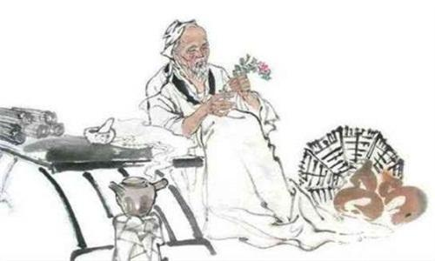
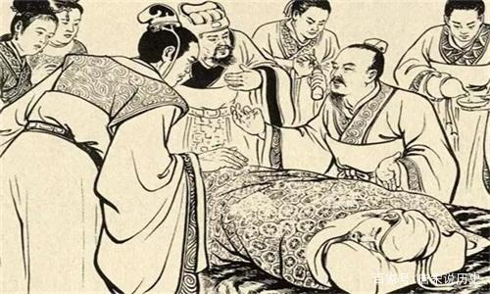
Do you know them?
大哥
二哥

